Slide 1
Dislocations

Slide 2
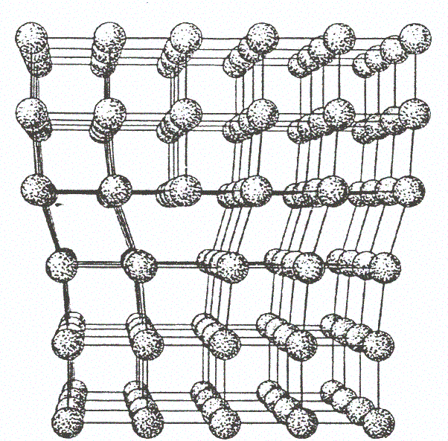
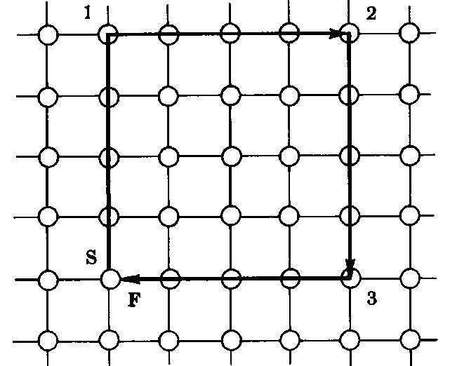
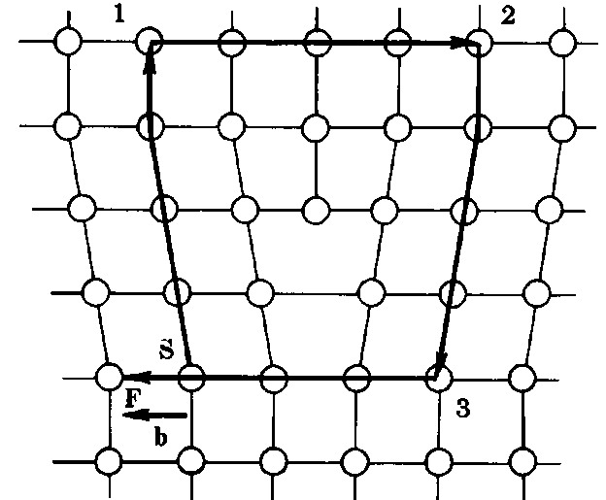
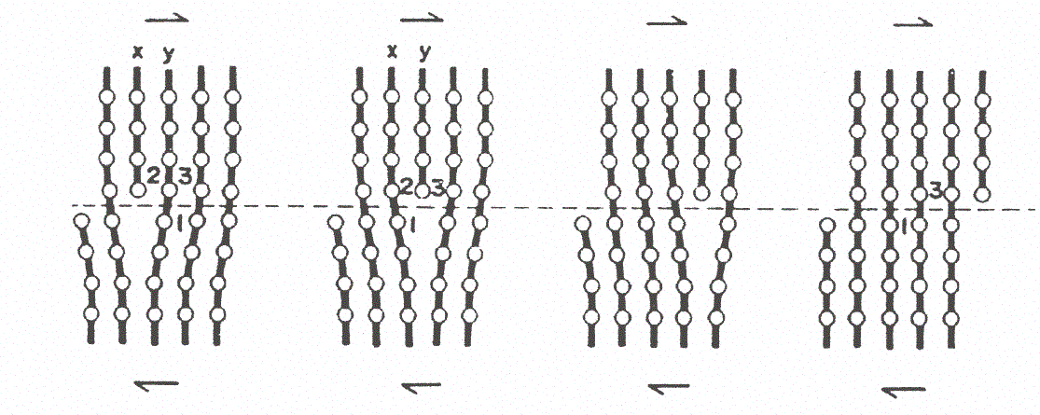
Dislocations
Edge type
Edge dislocation: line normal to slide
Burgers circuit & vector
Shear along Burgers vector
Dislocation glide under shear is the most frequent mechanism whereby metals are irreversibly deformed (plastic deformation)

Slide 3
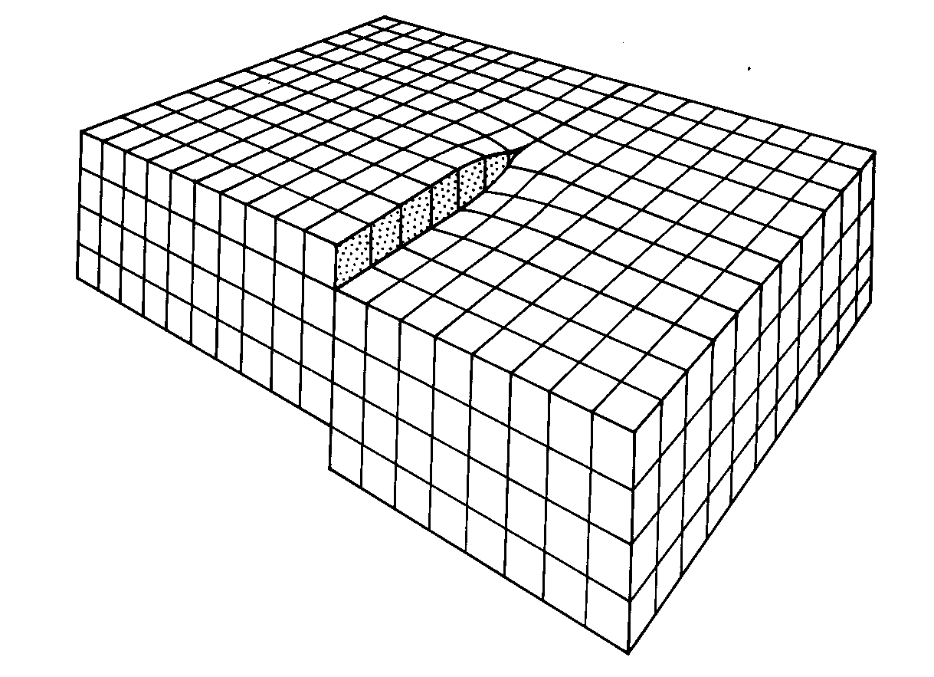
Dislocations
Screw type
Dislocation line parallel to Burgers vector and to shear direction

Slide 4
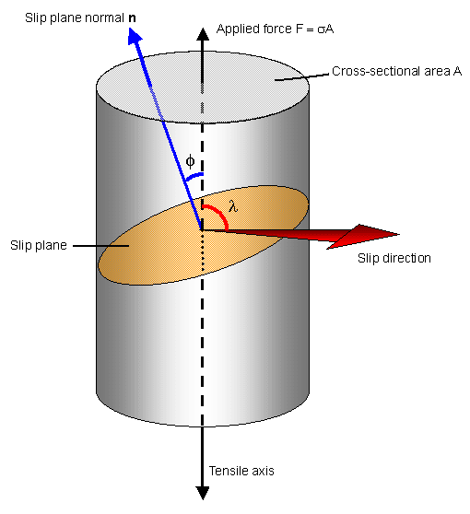
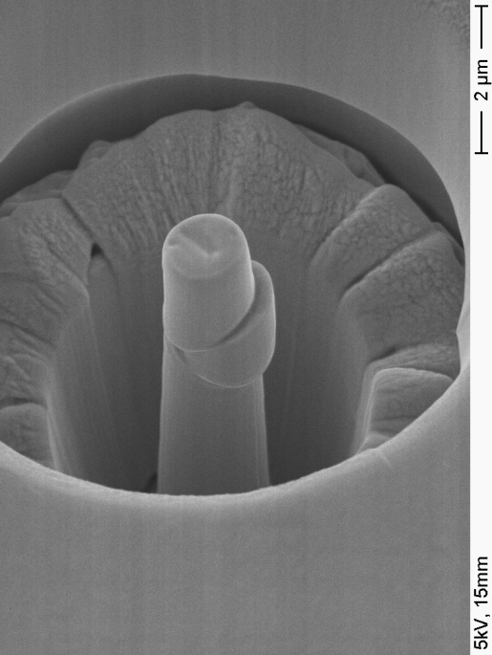
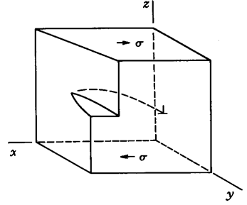
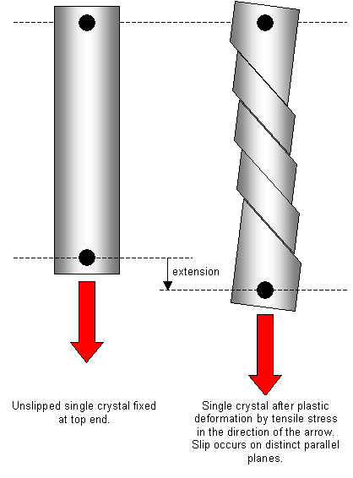
Metals deform plastically via dislocation motion
Compression test on nano-pillar in single grain
Mixed dislocation line inside a grain gliding on a slip plane
Deformation under tension of single crystal along slip planes

Slide 5
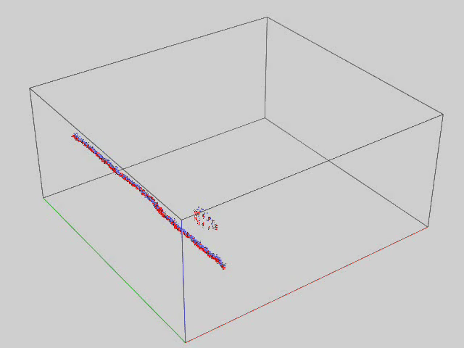
What happens when a dislocation meets a loop
Courtesy of L. Malerba and D. Terentyev (SCK-CEN)
Edge dislocation interacting with SIA loop at 600 K

Slide 6
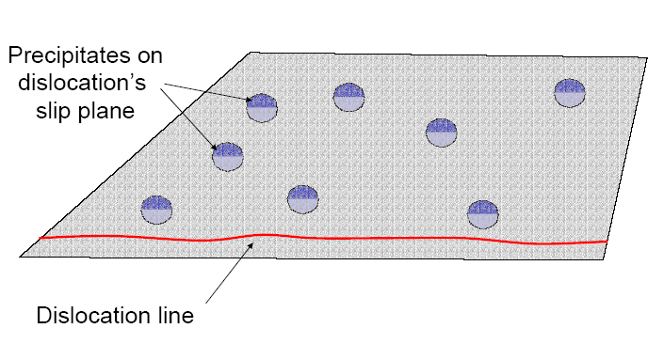
Shearable obstacles

Slide 7
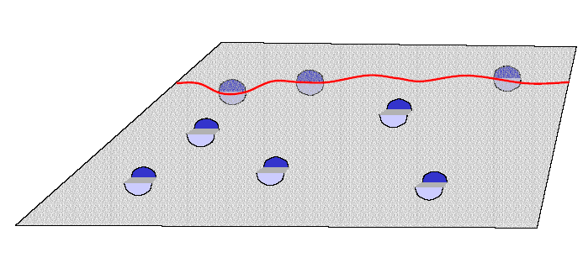
Shearable obstacles

Slide 8
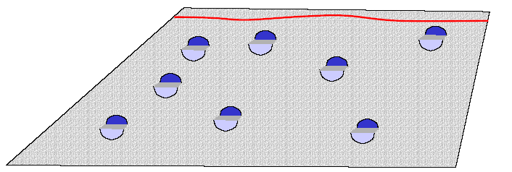
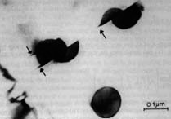
Shearable (weak) obstacles
Dislocations can cut through the obstacle: the bigger, the more difficult to cut it through
Elastic, chemical, and phase stability effects also play a role to determine obstacle strength
Increasing strain ‘chops up’ sheareable obstacles

Slide 9
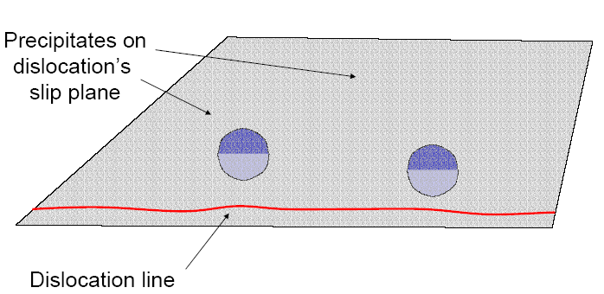
Impenetrable obstacles

Slide 10
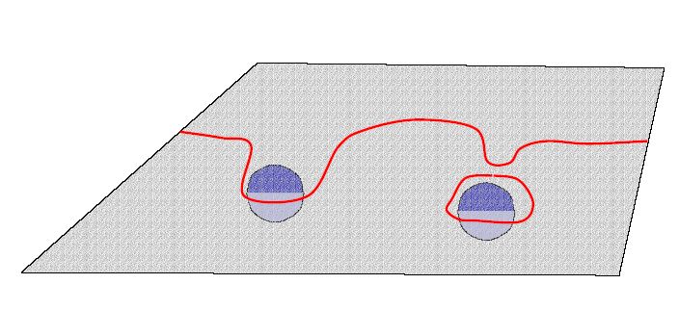
Impenetrable obstacles

Slide 11
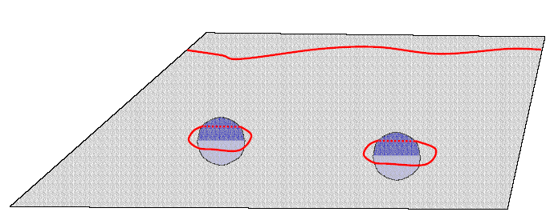
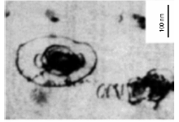
Impenetrable obstacles
Orowan loop
The bigger the spacing between obstacles, the easier for the dislocation to squeeze through the gaps.
Each ‘bypass’ event leaves a dislocation loop behind, narrowing the gaps and increasing hardening.

Slide 12
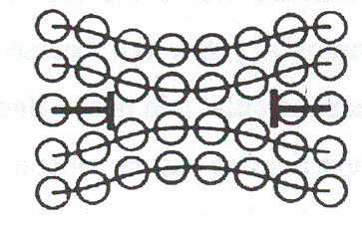
Orowan loops are NOT ‘prismatic’ loops
Orowan loops
Vacancy-type prismatic loop
Interstitial-type prismatic loop

Slide 13
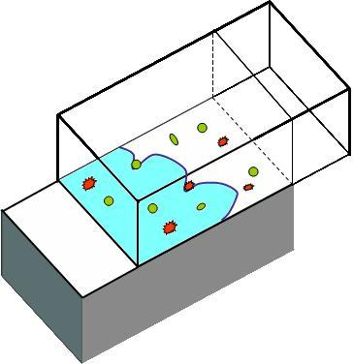
Why does the yield strength increase after irradiation?
applied shear
pinned dislocation
Defect populations act as obstacles for dislocations

Slide 14
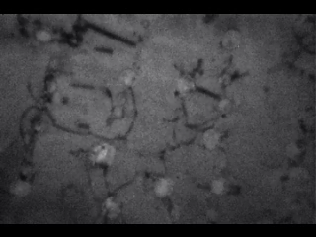
Dislocations pinned by obstacles: the movie
In-situ straining TEM – Courtesy Prof. Matsui

Slide 15
Take home messages
Dislocations are defects that always exist in metals (and other materials) and make irreversible (plastic) deformation possible
This is why metals are ductile: they can deform before breaking
The yield strength is the stress to be applied to make dislocations move in a material
The presence of defects (loops, voids, precipitates, …) from irradiation makes dislocation glide more difficult → the yield strength increases, the material becomes harder

